Slide 1

WHY HUMANA

Slide 2

We Are HUMANA

Slide 3
Agenda
Humana Difference
Product Overview
Supplemental Benefits & Tools
Clinical Strategy
Providers
Compliance Updates
Q & A
3

Slide 4
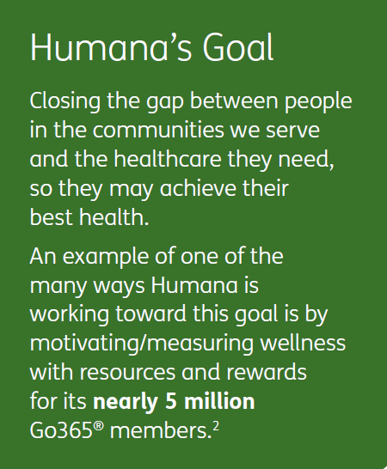
About Humana
Leading healthcare company by membership that offers a wide range of Medicare health insurance plans and health and wellness services
Founded in 1961 and headquartered in Louisville, Kentucky
More than 30 years of experience in the Medicare plan industry
One of the nation’s top providers of Medicare Advantage benefits by membership1
More than 3 million Medicare Advantage members
More than 5 million Part D (prescription drug plan) members

Slide 5
More great reasons to choose Humana
Veterans support
  Humana has many programs and initiatives to support veterans in addition to our veterans’ plans. Here are examples:
    • Educating veterans about Medicare to help meet their needs, regardless of their plan choice
    • Supporting the VFW and AMVETS since 2012
    • Collecting more than 30 tons of clothes to help homeless veterans
    • Donating well over a million dollars to veterans organizations and others that support veterans3
    • Employing 3,300 veterans and/or their spouses since August 2011
    • Investing countless hours training internal and external licensed sales agents to help veterans make informed choices about Medicare
    • Many grass-roots efforts, events and sponsorships
Consumer experience is a priority
  Humana ranked No. 2 for best customer experience in the health insurance industry, according to Temkin’s national customer experience survey
We are dedicated to providing clinical capabilities to help people achieve their best health, including:
  • Humana At Home care management support for those who qualify
  • 24-hour Nurse Advice Line
  • MDLive telemedicine from the comfort of home
Products and services designed to meet your customers’ needs
  • Local market support
  • Many plans with large, robust networks
  • Competitive, stable products

Slide 6

2018 Product Updates

Slide 7
You Spoke, We Listened!
Lower PCP Copays
Lowered MOOPs
Lowered Rx Copays
Higher OTC Benefit amounts
More Part B giveback areas
New Rx Formulary- more drugs in Tier 1 (moved from Tier 2 to 1)
Many areas now have no referrals for HMO
Expanding Dual SNP Markets
    *Please refer to plan’s Summary of Benefits, this is a just a high level overview of changes

Slide 8
2017 Top MA States
Top Counties |  | MA Top State- CC | %
Cook, IL |  | Florida | 14.0%
Dallas, TX |  | Texas | 10.3%
Broward, FL |  | Louisiana | 6.7%
Philadelphia, PA |  | North Carolina | 5.3%
Harris, TX |  | Ohio | 5.0%
Clark, NV |  | Georgia | 4.7%
Hillsborough, FL |  | Alabama | 4.1%
Maricopa, AZ |  | Virginia | 4.0%
Contra Costa, CA |  | California | 3.5%
Palm Beach, FL |  | Tennessee | 3.5%
Marion, IN |  | Pennsylvania | 3.3%
Franklin, OH |  | Illinois | 3.3%
Tarrant, TX |  | Indiana | 3.0%
Los Angeles, CA |  | South Carolina | 2.9%
Pinellas, FL |  | Kentucky | 2.9%
Volusia, FL |  | Mississippi | 2.5%
Jefferson, LA |  | Arizona | 2.1%
Jefferson, AL |  | New York | 2.0%

Slide 9
2018 Expected Growth Markets
Florida
KY
Indiana
Washington (Seattle, Southwest)
AZ (Phx)
Mississippi
Louisiana
Texas (Houston, Dallas, LPPO)
PA (Greater Philly)
Ohio (Cincy, Canton, Akron, Cle)
Virginia (Richmond, Tidewater)
Minnesota (Minneapolis)
Chicago
Michigan (Detroit)
Tennessee (Nashville, Tri Cities, Knoxville)
Alabama (Birmingham, Huntsville)
Georgia (Atlanta)
South Carolina (Columbia, upstate, Charelston)
North Carolina (Charlotte, Greensboro, Western)
Nevada (Las Vegas)
Colorado
MO/KS
Wisconsin (Milwaukee)
New York City
Iowa (Des Moines)
Los Angeles/Orange

Slide 10
2018 Product Expansions
 | Counties in New Markets | Expansion counties in existing Markets | Total
LPPO | 49 (11 new markets) | 32 (14 existing markets) | 81 (880,580 eligible)
HMO | 76 (4 new markets) | 51 (15 existing markets) | 127 (653,930 eligible)
Humana is expanding LPPO & HMO footprints for 2018:
  880,580 eligible will gain access to Humana LPPO Product
  653,930 eligible will gain access to a Humana HMO Product
No expansion or service area changes for RPPO & PDP
Notes:
Reducing plan volume and complexity
The plan count went from 483 for 2016 to 455 for the 2017 calendar year
Premium and Benefit Changes
Benefit and premium increases expected to impact the fewest number of members in four years

Slide 11
2018 HMO Expansion Markets
2018 – 921 Total HMO Counties
New Markets:
Hattiesburg, MS
VA-Over 60 counties
Western, NC (Ashville metro)
Western, WA-Kitsap County
Expansion Markets:
Atlanta, GA
Billings, MT
Birmingham, AL
Delaware, DE
Evansville, IN
Ft. Wayne, IN
Greenville, SC
Huntsville, AL
Indianapolis, IN
Iowa, IA
Las Vegas, NV
Montana, MT
Oklahoma City, OK
South Bend, IN
South Dakota, SD
2017 – 807 Total HMO Counties

Slide 12
Value Plus Plans
Regular MAPD plan; not an actual D-SNP plan
  Does not require a Model of Care/Care Coordination
Sales strategy is to enroll duals, but can not limit membership
  Members may receive an enrollment letter stating they will pay cost-shares
Benefit structure may be appealing to Duals who receive cost-share protection
  Cost-share protected members can not be balance billed
Identifiable by the word “Value” in the plan name
  Ex. Humana Value Plus
  One CarePlus plan called “CareExtra” in Miami-Dade
Notes:
Humana is expanding the Value Plus footprint in areas where Humana wants to focus on gaining membership from the dual population and take advantage of year round selling opportunities. Value Plus plans can be identified by the words “Value Plus” in the Humana plan name, or “CareExtra” for CarePlus (1 CarePlus Plan). These plans are Individual Medicare Advantage plans that will mostly appeal to duals because of the benefit structure. The benefit structure for many services matches Original Medicare coverage, while other services more heavily utilized by the dual population are at a low to no cost. Mandatory Supplemental Benefits may also offer additional benefits beyond what a dual person would receive through their Medicare and Medicaid coverage alone. Additionally, some plans offer lower cost-shares than Low Income Subsidy “Extra Help” provides.
In about 15 states, many counties in KY, VA, WV, PA

Slide 13
LPPO Expansion Markets
2018 – 1,680 Total LPPO Counties
New Markets:
Central North Carolina*
Columbia, SC*
Duluth, MN
Idaho, ID
Intermountain
Kansas*
Mississippi*
New Hampshire, NH
New Mexico, NM
South Carolina Select*
West Central
Expansion Markets:
Central Indiana, IN*
Cleveland, OH*
Colorado, CO
Delaware, DE
Greater GA*
Las Vegas, NV
Missouri, MO*
North Florida, FL*
Oklahoma, OK*
Outstate, WV*
Pittsburgh, PA*
Suburban, IN*
Texas, TX*
Western Maryland, MD
*RPPO States
2017 – 1,609 Total LPPO Counties

Slide 14
LPPO VS. RPPO
Product type is the same but the key difference is the plan service area for a given RPPO or LPPO plan.
RPPO plans must have a service area that matches the CMS defined regional service areas vs a LPPO plan can have a custom service area that services one county or the entire state
Humana contracts providers at the PPO product level. There would likely be no difference in network size for a given geography due to this contracting measure.
Similar to last year, for 2018 AEP a focus in Florida, Michigan and Texas will continue to be reselling RPPO members to better valued LPPO plans.

Slide 15
Part B Giveback Markets
North Carolina:
  $52 Giveback-Greensboro LPPO – Alamance, Guilfore, Randolph, Rockingham counties
South Carolina:
  $50 Giveback-Columbia HMO – Richland County
Pennsylvania :
  $40 Giveback-Greater Philly HMO – Bucks, Chester, Deleware, Montgomery, Philadelphia counties
Mississippi:
  $40 Giveback-Jackson Metro HMO – Attala, Copiah, Hinds, Madison, Rankin counties
New Hampshire:
  $40 Giveback-LPPO – MA version and MAPD version – Belknap, Carrol, Hillsborough, Marrimack, Rockingham, Strafford counties
New Mexico
  $40 Giveback-Southern NM PPO – Dona Ana, Luna, Otero, Chaves counties
New York:
  $40-$50 Giveback-MA and MAPD LPPO – Allegany, Broome, Cattaragus, Chautauqua, Chemun, Chenanago, Corland, Schuyler, Steuben, Tioha, Yates, Cayuga, Herkimer, Jefferson, Lewis, Madison, Oneida, Onondaga, Oswego, Albany, Green, Montgomery, Rensselaer, Saratoga, Schenectady counties
Oklahoma:
  $25-$40 Giveback-Tulsa LPPO – Okmulgee, Tulsa, Wagoner , also an MA only version
Kansas:
  $25-$40 Giveback, LPPO – MA Only serving multiple counties
Arkansas:
  $25-$40 Giveback-LPPO – Faulkner, Garland, Pulaski, Saline counties, Also an MA only version
Montana:
  $25-$40 Giveback- LPPO – MA Only serving multiple counties
Florida:
  $75-$94 Giveback
  Daytona HMO – Volusia and Flagler counties,
  Great Tampa Bay HMO – Citrus, Hernando, Hillsborough, Pasco, Pinellas, Manatee, Polk. Hardee, Highlands, Sarasota counties
  o Northeast/Jacksonville HMO – Alachua, Clay, Columbia, Putnam, St. Johns,
  o Orlando HMO – Orange, Osceola, Seminole counties
  o Panhandle HMO – Bay, Escambia, Santa Rosa, Walton counties
  o Broward HMO – Broward county

Slide 16
Humana’s D-SNP Eligible Categories
State | $0 C/S* | Covered Categories
AL | N | QMB, QMB+, SLMB, SLMB+, QI, QDWI, FBDE
CA | Y | QMB+, SLMB+, FBDE
FL | N | QMB+, SLMB+, FBDE
 | N | QMB, SLMB, QI, QDWI
GA | Y | QMB, QMB+, SLMB+, FBDE
IN | Y | QMB, QMB+
KY | Y | QMB, QMB+
LA | Y | QMB, QMB+, SLMB+
ME | Y | QMB, QMB+, FBDE
MS | Y | QMB, QMB+, SLMB+, FBDE
MO | Y | QMB, QMB+
State | $0 C/S* | Covered Categories
MT | Y | QMB and QMB+
NE | Y | QMB, QMB+, SLMB+, FBDE
NY | Y | QMB, QMB+, FBDE
NC | Y | QMB, QMB+, SLMB+, FBDE
OH | Y | QMB, QMB+, FBDE
PA | Y | QMB, QMB+, SLMB+, FBDE
PR | N | All categories
SC | Y | QMB, QMB+, FBDE
TN | Y | QMB, QMB+, SLMB+, FBDE
TX | Y | QMB, QMB+, SLMB+
WA | Y | QMB, QMB+, SLMB+
Red denotes expansion area

Slide 17
Chronic SNPs
Add for 2018
Will County, IL
Current States:
CO
FL
IL
IN
KY
LA
NO
NV
OH
TX
VA

Slide 18

Market Highlight Document
Includes Value Props
Network wins
Competitive advantages
Plan Grids
How to use this?

Slide 19
Stand Alone PDP 2018

Slide 20
2017 Top PDP States
PDP Top State- CC | %
Texas | 8.6%
Ohio | 7.1%
California | 6.8%
Florida | 6.0%
Tennessee | 5.0%
Illinois | 4.1%
Pennsylvania | 4.0%
Virginia | 3.5%
North Carolina | 3.4%
Georgia | 3.1%
Arizona | 2.7%
New Jersey | 2.7%
Michigan | 2.4%
Alabama | 2.4%
New York | 2.3%

Slide 21
2018 Humana’s Prescription Drug Plans
Notes:
Went up from 400 to 405
Went from up to $3700 to up to $3750

Slide 22



2018 Plan-by-Plan Highlights
Humana Preferred Rx Plan (PDP)
Available in all regions
$405 deductible
Cost Sharing:
  Preferred same in all regions:
  $0/$1/20%/35%/25%
  Standard varies by region
  $2/$3/20-25%/35-50%/25%
  5-tiered formulary
Walgreens and Walmart are Preferred partners
Humana Enhanced (PDP)
Available in all regions
$0 deductible
Cost Sharing:
  Preferred same in all regions
  $3/$7/$42/44%/33%
  Standard same in all regions:
  $7/$12/$47/50%/33%
  5-tiered formulary
  Select T3 & T4 brands covered in gap
Walgreens and Walmart are Preferred partners
Humana Walmart Rx Plan (PDP)
Available in 34 regions (not available in Puerto Rico)
$405 deductible; only applies to tiers 3, 4, and 5
Cost Sharing:
  Preferred varies by regions :
  $1/$4/21-25%/35%/25%
  Standard varies by regions:
  $10/$15-20/25%/44-50%/25%
  5-tiered formulary
Walmart as Preferred partner
Co-Branded with Walmart
Last updated: 07.12.2017
PLEASE NOTE: Information subject to change based on CMS guidance

Slide 23
Medicare Supplement

Slide 24
2017 Top MSUP States
MSUP Top State- CC | %
New York | 9.63%
California | 8.39%
North Carolina | 6.69%
Maryland | 6.58%
Massachusetts | 6.02%
Florida | 3.78%
Pennsylvania | 3.63%
Georgia | 3.18%
Arizona | 2.93%
Illinois | 2.80%
New Jersey | 2.60%
New Mexico | 2.60%
Missouri | 2.44%
South Carolina | 2.44%
Louisiana | 2.35%
Wisconsin | 2.06%

Slide 25
Selection Process for Targeted States
Top Opportunity States Identified
Criteria used as follows:
1) How rates compare to competitors.
2) Strength of our MA plans.
3) Number of Medicare eligibles.
4) Percent of eligibles who are on a Med Supp plan.
5) 2016 Humana Med Supp membership.
6) YOY increase or decrease in Humana MS Membership.
7) Medical Expense Ratio (MER).

Slide 26
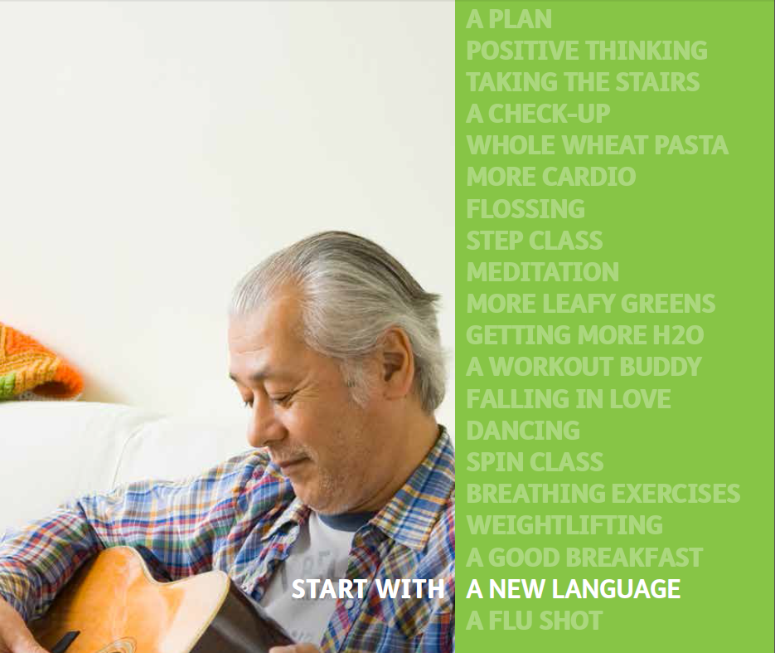
Supplemental Benefits & Tools

Slide 27

Well Dine
Humana offers 2 types of nutritious meal programs
1) Meals are available to members recovering from an inpatient stay in a hospital.
2) Meals are available for some Humana Medicare members enrolled in a qualified chronic-condition special needs plan.
Patients discharged from a hospital may receive 10 frozen, packaged meals. Patients who are eligible for the chronic condition meals program receive 20 frozen, packaged meal.
This program is available to members of most Humana Medicare Advantage group and individual plans. Please refer to the Summary of Benefits or Certificate of coverage for more information.
What is it?
Meals are provided to eligible members as part of their benefit plan and at no additional cost! Members may call 1-866-966-3257, Monday- Friday, 8:00am -9:00 p.m. (ET) to see if they are eligible for Well Dine under their plan benefits and to request participation in the program.
Meal delivery is arranged by Independent Living Systems (ILS). When a qualifying member requests meals for either the discharge or chronic meal program, Humana and ILS send a fax to the patient’s primary care provider or treating physician. Practitioners have a 24-hour window in which to change or cancel the meal request due to medical concerns. After that, ILS initiates meal delivery Meals are provided to eligible members as part of their benefit plan and at no additional cost.
Notes:
What is it?
Meals are provided to eligible members as part of their benefit plan and at no additional cost! Members may call 1-866-966-3257,
Monday- Friday, 8:00am -9:00 p.m. (ET) to see if they are eligible for Well Dine under their plan benefits and to request participation in
the program.
Meal delivery is arranged by Independent Living Systems (ILS). When a qualifying member requests meals for either the discharge or
chronic meal program, Humana and ILS send a fax to the patient’s primary care provider or treating physician. Practitioners have a 24-
hour window in which to change or cancel the meal request due to medical concerns. After that, ILS initiates meal delivery Meals are
provided to eligible members as part of their benefit plan and at no additional cost.

Slide 28
Health Coach
What is it?
Many plans may include a wellness program for members called Health Coaching. With this personalized service, the member can connect with a certified health coach.
The health coach will:
Coach and provide resources around a broad range of Health topics including:
  Weight Management
  Tobacco Cessation
  Stress Management
  Healthy Eating
The health coach can communicate with the member telephonically and online.
Why You Should Talk About It
This is an option available to some members and it can make a difference in their lives.
Check out this video to learn more: Health Coach

Slide 29
Health Coach

Slide 30

Silver Sneakers
What is it?
Silver Sneakers provide a basic health club membership, at no cost, to members on many MA/MAPD and Medicare Supplement plans at participating Silver Sneakers facilities. Home workout instruction is provided to members who live more than 15 miles from participating facilities.
Silver Sneakers provides a basic health club membership to members at participating Silver Sneakers facilities.
Members can take their Silver Sneakers membership card to a participating location and the staff will walk them through the enrollment process.
Why You Should Talk About It
The program lets the member workout where and how they want to no matter what their ability level or goals. Sliver Sneakers is a great way to jump-start that exercise program they have always wanted to start!
Silver Sneakers location finder: https://tools.silversneakers.com/LocationSearch

Slide 31
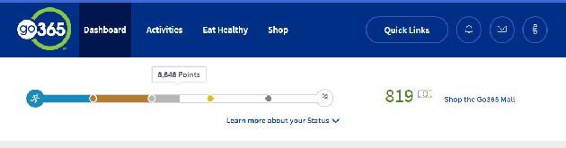
GO/365
What is it?
Go/365 by Humana is a personalized rewards program designed to help members get motivated to make healthier choices. As the member completes healthy activities, they earn bucks that they can use to spend in the Go365 mall on items like gift cards, and fitness equipment.
Why you should talk about it?
Easy. The member is already enrolled! They can refer to the Member well-being kit they receive/d in the mail and if they have questions, they can contact customer care at the number on the back of their Humana ID card.
It’s personal. If they complete the Go365 Health Assessment, Humana will recommend activities to help them get and stay on a personal path to wellness.
It’s rewarding. They earn Bucks for eligible activities they complete.

Slide 32
Over the Counter Benefits - OTC
What is it?
This benefit gives the plan member a monthly dollar value to spend on approved over the counter health and wellness products from a participating pharmacy.
Covered over-the-counter items include; vitamins, pain relievers, cough and cold medicines, allergy medications, and first aid/medical supplies.
Why You Should Talk About It
This is a great benefit to discuss with a prospective member to show how Humana works to save them money and keep them healthy! It’s also a great introduction to Humana Pharmacy!
https://www.humana.com/pharmacy/medicare/drugs/otc
How to Place an Order
• Online: Go to HumanaPharmacy.com/OTC
• Mail: Fill out the OTC Health and Wellness Product Order Form
• Fax: Fill out the OTC Health and Wellness Product Order Form and fax only the order form pages to Humana Pharmacy at: 1-800-379-7617.

Slide 33
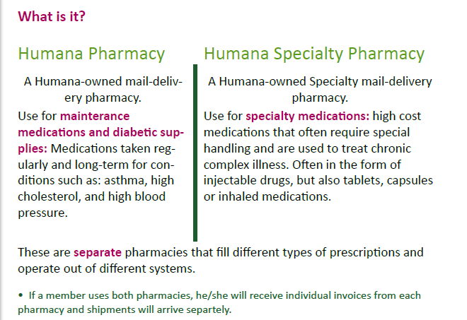
Humana Pharmacy | Humana Specialty
14

Slide 34
Why Humana Pharmacy?
Savings
Med Adherence
Easy to Use
Convenience
Accuracy & Safety
Mail-delivery pharmacies may be able to reduce a member’s out-of-pocket costs by ~15% on average, per prescription¹
Some Medicare plans offer $0 copayment on most Tier 1 and generic medicines when a member orders a 90-day supply²
Mail-delivery pharmacy users who obtain a 90-day script of diabetic-related medication were ~8 % more likely to take their medicine as their doctor prescribed than those who used retail pharmacies³
Humana Pharmacy will call user when it’s time to refill/renew prescriptions
Reminders can be set up and received by phone, email or text message; members can set their own communication preferences when they sign up
With Humana Pharmacy Online and the Humana Pharmacy Mobile App, getting prescription information, checking order status, and refilling is made easy
Members can get a three-month supply shipped to their home, that’s only 4 orders per year
Two pharmacists check new prescriptions for accuracy and to avoid any interactions with other medicines you’re taking.
Heat-sealed bottles with tamper-resistant foil also help ensure quality and safety.
1. Based on the study “How Mail-Service Pharmacies Will Save $46.6 Billion Over the Next Decade and the Cost of Proposed Restrictions”, created by Visante® for the Pharmaceutical Care Management Association, 2012.
2. Certain medicines are only available in a 30-day supply, deductibles may apply.
3. O. Kenrik Duru et al., “Mail-Order Pharmacy Use and Adherence to Diabetes-Related Medications,” American Journal of Managed Care, Volume 16, Issue 1, pp 33-40 (2010).
34
GCHJNE7EN For Agent Use Only

Slide 35
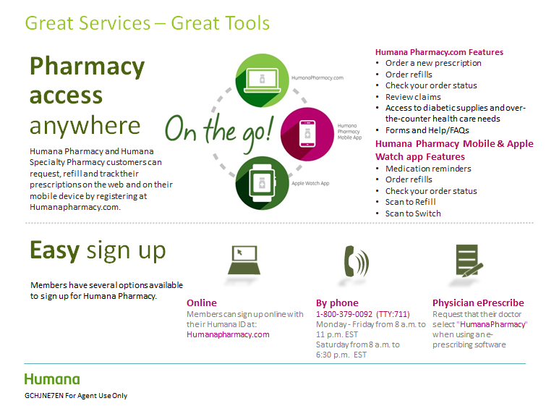

Slide 36
Humana in your Community
What is it?
  Our community locations (previously called Guidance Centers) are where we help our members understand and achieve their best health. Humana is part of the community offering a place where people can learn, become more active and meet their neighbors.
  Walking groups, Zumba, yoga and tai chic classes are offered which help promote fitness and flexibility and help people need fewer medicines and keep off unwanted pounds!
Click Here for locations.
Why You Should Talk About It
Community Humana provides a value that members can relate to immediately and broadens the scope of services with a benefit at no extra cost that members may not realize they have!
For example, each location has experts available to teach tips on planning healthy meals, and manage health conditions. And, each location is staffed by a customer service representative.
Is a Humana location in their area? If so, give the consumer the address then look at the events calendar and let the member know the type of activities available.
  Watch this video to see more about Humana in your Community:

Slide 37
Guidance Centers are located in key Medicare Markets
Southeast
Full Service | (NEW) Broward, FL
 | Kissimmee, FL
 | (NEW) Palm Beach, FL
 | Tamarac, FL
 | Zephyrhills, FL
 | Raleigh, NC
Lite | Altamont Spring, FL
 | Bradenton, FL
 | Clearwater, FL
 | Daytona Beach, FL
 | Fort Myers, FL
 | Jacksonville, FL
 | Orange City, FL
 | Pensacola, FL
 | Port Richey, FL
 | Spring Hill, FL
 | Tampa, FL
 | West Colonial (Orlando), FL
 | Asheville, NC
 | Greensboro, NC
 | Columbia, SC
 | Greenville, SC
Central
Full Service | Baton Rouge, LA
 | New Orleans, LA
 | Kansas City, MO
 | Knoxville, TN
Lite | Madison, AL
 | Rogers, AR
 | Lafayette, LA
 | Lake Charles, LA
 | Metairie, LA
 | Biloxi, MS
 | Ridgeland, MS
 | Shreveport, MS
 | Springfield, MO
 | Tulsa, OK
 | Kingsport, TN
 | Memphis, TN
Full Service Guidance Center
NEW Full Service Guidance Center
Guidance Center Lite
West
Full Service | Mesa, AZ
 | Las Vegas-NW (Summerlin)
 | Las Vegas-SE (Henderson)
 | Austin, TX
 | San Antonio, TX
Lite | Riverside, CA
 | Meridian, ID
 | Pahrump, NV
 | Albuquerque, NM
 | Corpus Christi, TX
 | El Paso, TX
 | Spring, TX
North
Full Service | (NEW) Chicago, IL
 | Lombard, IL
 | Peoria, IL
 | Louisville, KY
Lite | Indianapolis, IN
 | Speedway, IN

Slide 38
Humana in Your Community

Slide 39

Humana First Nurse Advise Line
What is it?
The nurse advice line offers members guidance in choosing the right level of care, and in using their benefits wisely. The nurses can connect members with specialty programs to address the unique needs of that individual. The nurse line is just a phone call away and available 24/7 at no cost to the member.
Why You Should Talk About It
When a health concern arises and the member is not sure what to do, they can call the Humana First Nurse Advise line for assistance. The Humana First Nurse Advise Line can help the member pursue appropriate care options when their physician is unavailable.
Humana First is not available in all markets. Please refer to the Summary of Benefits or Certificate of coverage for more information.
The 24-hour Nurse Advice Line no longer displays on the back of the ID card. Members can access the Humana First Nurse Advise Line at 1-800-622-9529.
This service is not intended for emergencies

Slide 40

Clinical

Slide 41
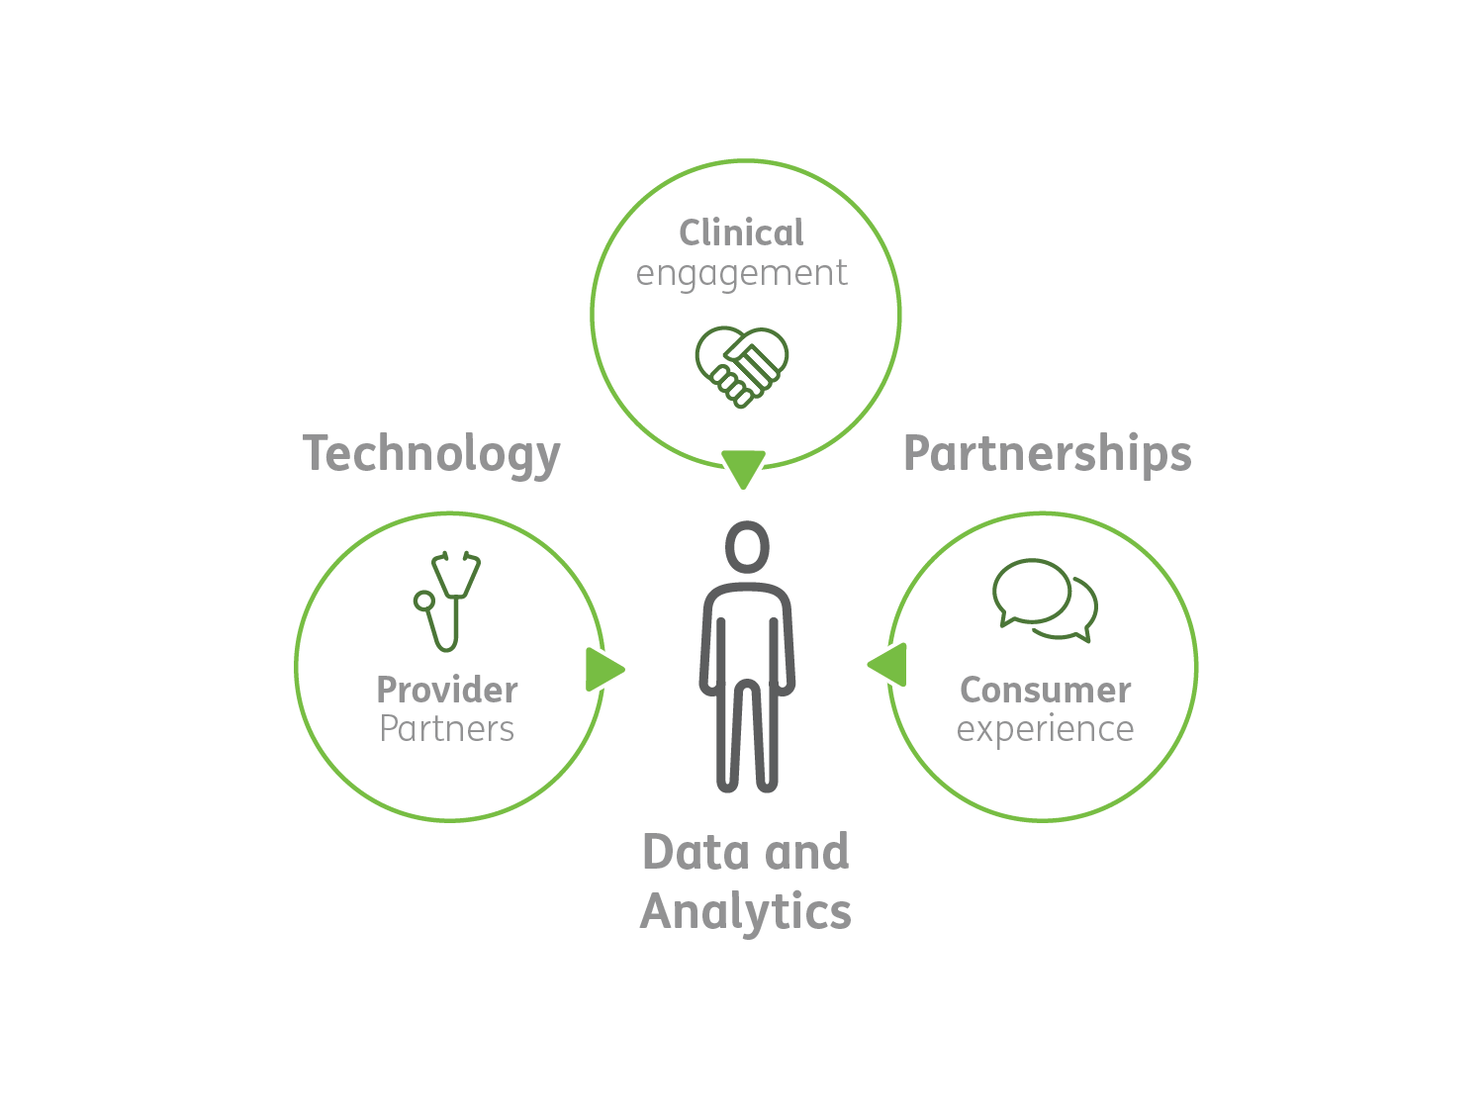
Humana’s Integrated Care Delivery Strategy
Our integrated care model is focused on three key areas:
Slowing disease progression
Improving health
Lowering healthcare costs
Notes:
Rising healthcare costs and the prevalence of chronic conditions call for a sustainable model, focused on quality of care while:
— Slowing disease progression
— Lowering medical costs
— Improving health
Integrated care delivery will enable better health outcomes and a truly personalized experience for each member.

Slide 42




















Casting a Broader Net
Non- traditional areas that impact people’s health
Traditional scope of healthcare system
Access to Good Food
Access to Care
Alternative
Care
Mental
Health
Informatics
Pharmacy
Care at Home
Benefit Design
Lifestyle Habits
Lab and Diagnostics
Specialist / Outpatient
Services
Community Resources
Transportation
Long Term
Care
Primary
Care
Nutrition
Education and Coaching
Real-time Monitoring
Hospital / ER
Skilled Nursing
Chronic Care Coordination
Technology

Slide 43

New Member Assessment (Welcome Calls)
Welcomes Medicare program enrollees within 90 days of eligibility per CMS requirements.
  Outcomes
  91% of eligible members
  were contacted
  72% of those contacted completed HRA
Engaged
Empowered
1
  Thanks member
  for choosing Humana
Proactive
Humana Member
National Data – 2017
2
  Answers member’s
  questions
3
  Asks member to complete
  a brief Health Assessment
4
  Determines at-risk members
  or dual eligible status
5
  Directs member to additional resources if needed
Notes:
Updated Slide: 3/20/2015
LOB: Medicare
Contact: Gina Pyon
Welcomes Medicare program enrollees within 90 days of eligibility per CMS requirements. First attempts are made within 30 days of enrollment.
Have HRA stats but not week-by-week, just overall. And have high level explanation of the importance of HRA – drives outreach efforts, drives medical loss ratios, etc.

Slide 44




Robert’s Journey with Humana
Predictive Modeling
Robert receives a welcome call and takes a Health Risk Assessment
Identified for nurse outreach by predictive modeling that includes claims, HRA, and other data
Initial Outreach
Outreach initiated by a Humana At Home referral specialist
Makes an appointment for a Care Manager to reach out telephonically
Robert’s journey with Humana
On-going Care Manager Support
Robert’s care manager does an initial assessment of Robert’s needs, including an in home assessment, if necessary
Robert and his Care Manager develop a plan that emphasizes well-being and following physician guidance
Robert’s Care Manager consults with his doctor, monitors for gaps in care and compliance with prescribed medications
Robert
67, Group Medicare Retiree
Improving health
The goals are to help Robert manage his chronic conditions, offer support, guidance, and accountability
Surrounds Robert with resources to help him achieve his best healh and age with dignity in the home
Robert Benefits From:
Managing his chronic conditions and functional limitations through services offered by Humana
Avoiding future ER and hospital admissions, reducing stress
Early awareness of a potential gaps in care
Education and personalized attention to help Robert improve his health
Robert is not an actual member, but an example of the typical Humana Medicare member experience.
Notes:
Key Messages:
Meet Robert. A retired Verizon employee with diabetes and a history of heart disease
Medical History: Type 2 diabetes; Has had heart bypass surgery; Father died from heart disease; Possible depression; Experienced dangerous dip in blood sugar resulting in a visit to the ER and an admission
Unhealthy Behaviors: Irregular visits to Primary Care Physician (PCP); Does not always take his prescribed medications; Has not had a cholesterol (LDL) screening in the past 12 months; Has gained weight and is interested in weight loss
We would like to use Robert’s story to walk through some examples of how Humana is positioned to reach and care for your members
After Robert was enrolled in Humana’s Group Medicare, he took a health assessment
Through Humana’s use of daily analytics on every member, we were able to identify that Robert had a gap in care that could be affecting his health – he had not seen his PCP in 3 years
Due to Robert’s diabetes, gaps in care and other factors, he was enrolled in Humana At Home and given a care manager to co-develop a health plan to get Robert on the right track to happy and healthy living. Now, let’s go into detail on how exactly each of those element’s work together while continuing to use Robert as an example

Slide 45




Humana At Home
  Care is shifting to the home to meet consumer needs and improve outcomes, consumer experience, and costs
  Current care coordination capabilities have achieved significant clinical and financial results
  Transitioning from care coordination to care delivery in the home to continue to improve outcomes

Slide 46




Caring for the sickest members impacts the majority of healthcare costs
Healthcare costs
Home visits
Regular calls
Less frequent calls
Interventions tailored
to individual needs
and preferences
Members
  These people:
  Have multiple hospital and emergency room visits
  Have chronic conditions and functional, behavioral, or cognitive deficits
  Are likely to be sickest members in future
46
Notes:
25% of our members account for 80% of the overall spend

Slide 47
Uniquely holistic care management services
Services for Medicare & Medicaid
Multi-tiered strategy includes 7 domains beyond medical needs
Services for Commercial
Specialized nurses offer specialized services
Health
Medical conditions and needs, medicines
Function
ADLs, IADLs
Financial
Ability to pay for daily living needs
Environment
Safety and other factors in the home
Psychosocial
Support of family and friends
Cognitive
Memory
Behavioral
Depression and other mental health challenges
Personal Nurse
Chronic and acute conditions
Cancer Program
Humana Beginnings
Prenatal and neonatal
47
Notes:
In a fragmented health system, HAH offers a unified approach, bringing facets of health together holistically.
Many frequent utilizers of the health system are afflicted with some combination of poverty, homelessness, mental illness, addiction and past trauma.
A care manager might help someone, for example, pay unpaid utility bills that otherwise could lead to insulin spoiling in nonfunctioning refrigerators and limit their access to fresh food.
Commercial Care Management
Unlike Medicare members who are primarily seniors, commercial members are primarily age 18-64
This area is headed up by Leslie Lathon, who has been at Humana for several decades, and the care management is provided by nurses who have expertise in cancer, maternity and prenatal care, or general chronic and acute care.
Nurse care managers support members in self-managing cancer medication side effects, in navigating care of a prematurely born baby and even in managing their diabetes or asthma.
The model is focused on medical needs and nurses frequently co-manage members with Behavioral Health and other areas of Humana

Slide 48







Humana At Home services for people with medical and functional challenges
Ongoing telephonic and in-home (field) care management
Doctor and nurse practitioner home visits
Medicare-certified home health services
Home health aides employed in homecare clinical offices
Technology-assisted care such as remote monitoring and online portal
30-day care management post-facility discharge
Expert nurses who specialize in cancer, maternity, and other health conditions
48

Slide 49
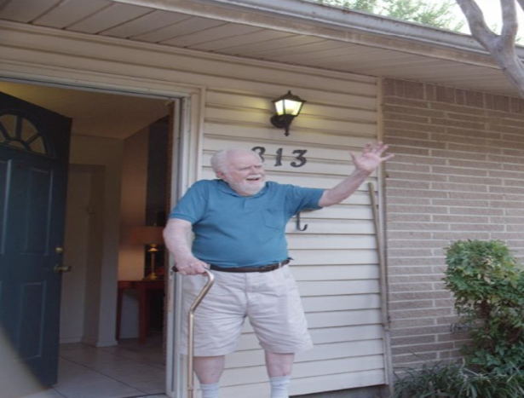
Humana At Home services provide holistic care to help adults remain independent at home
even when faced with medical, functional, and behavioral challenges
Meet Donald.
Click here to see a video about a
Humana At Home member
49
Notes:
https://www.youtube.com/watch?v=cMzYem8eg1Q

Slide 50
Meet Donald

Slide 51


Improved outcomes through consumer-centric approach
Consumer
satisfaction¹
Improved
outcomes²
Consumer
Experience³
87% engagement rate
44%
reduction in hospital admissions
Over 1M
more days at home
52% net promoter score
26%
increase in odds of survival for HCCP members
¹ HCCP 2016 data
² Humana At Home client results (N=116,145) Jan. 1, 2013 - Dec. 31, 2013. AND Humana At Home Results. Hall B et al. Presented at: Society for Medical Decision Making 34th Annual Meeting; October 2014;Miami, Florida. (N= 57,041)
³ CIA Analysis of 604,000 newly managed members have 1 million more days at home as compared to their experience prior to Humana At Home
51

Slide 52




MDLIVE
Leading provider of Virtual Care – currently servicing
  25 Million Members
  Over 30 Health Plans & 400+ Hospitals
  Large Fortune 500 customer base
  Experience you can count on
Extensive portfolio of virtual care services
  Medical
Health Plan Client Retention
  100% -the only provider- (NPS of 67%)
Certifications
  ATA and NCQA

Slide 53





MDLIVE at a Glance
One of the nation’s largest virtual care networks
25 million members January 2017
<10 minutes average wait time
State-licensed, board-certified physicians with an average of 15 years practice experience
NCQA accredited for CVO and Cred/Recred

Slide 54

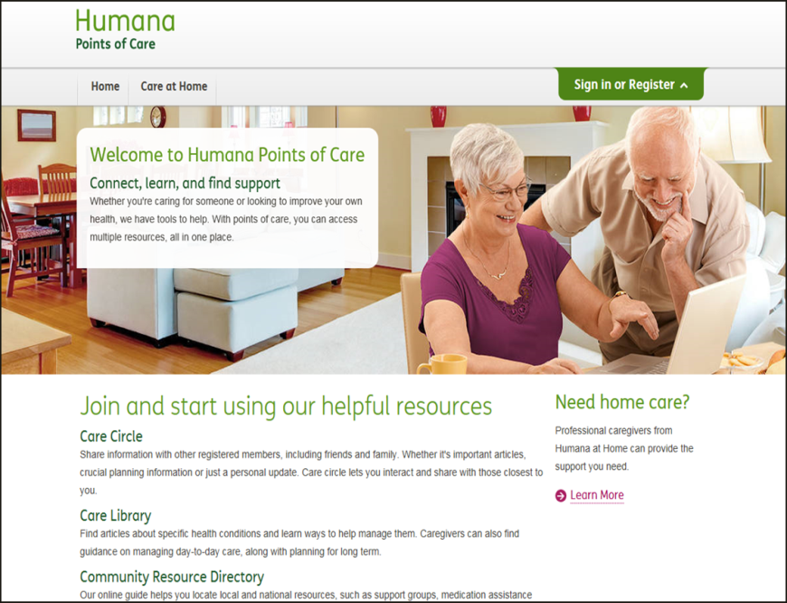
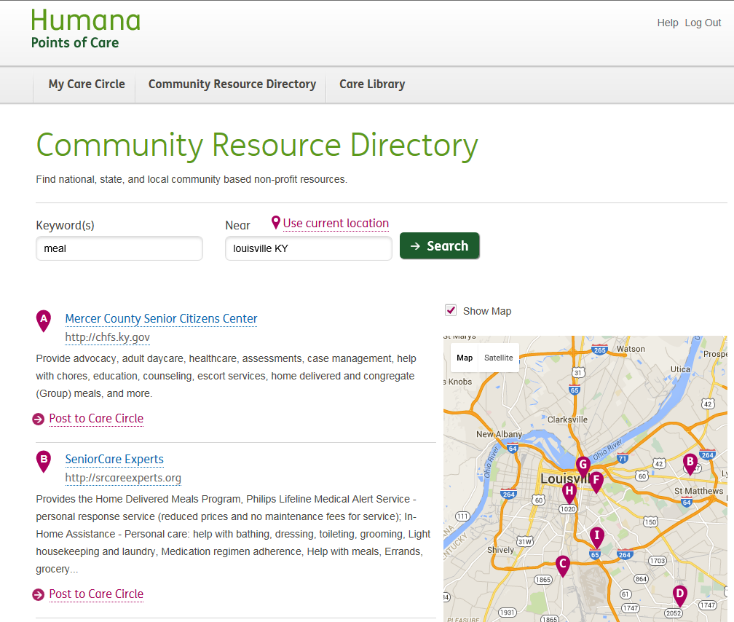
Points of Care Web Portal
Points of Care Web Portal
Facebook-Like Care Circle
Resources to support Members & Caregivers
Member invites “friends” such as caregiver, care manager, provider
Health Information
Community Resource Directory
  ~40K vetted resources
  7,700 new added in 2015
  73% of members cite resources as helpful or extremely helpful
Over 30K registered Members
3K connected Care Managers
Hundreds of Care Circle connections between Members, Care Managers, Caregivers and friends collaborating their care

Slide 55
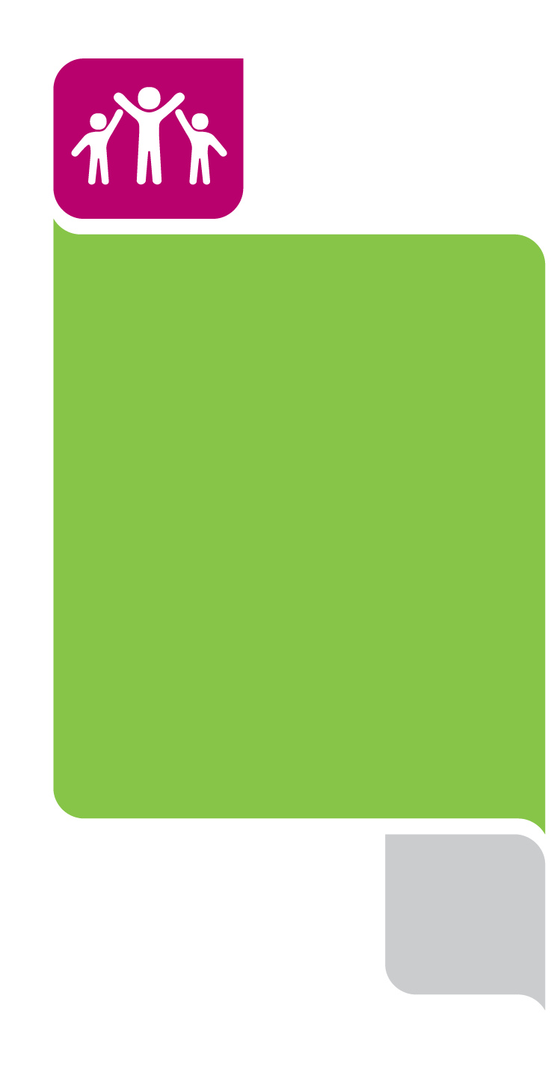

Introducing
Humana 2020
20% HEALTHIER BY 2020
For more information, visit www.CloseTheGap.Humana.com
Notes:
Our Enterprise Goal:
Every community we serve will be 20 percent healthier by 2020 because we make it
easy for people to achieve their best health

Slide 56
Our Bold Goal – 20% healthier by 2020
What is it?
Humana’s Bold Goal is our enterprise-wide goal that the communities we serve will be 20 percent healthier by 2020 because we help make it easy for people to achieve their best health. We will reach our goal because we are focused on addressing social determinants of health (barriers) like food insecurity and loneliness/social isolation, and using a collective impact model to co-create solutions and design pilots and programs that measure Healthy Days with community stakeholders.
What is a Healthy Day and why should we care?
Healthy Days is a U.S. Centers for Disease Control and Prevention (CDC) tool that measures individual mental and physical Unhealthy Days in a given month. We like the Healthy Days tool because it takes into account the whole person and it’s easy to use and talk about. We want our associates and our members to have a Healthy Day, every day.
Where are our Bold Goal communities?
We are in seven Bold Goal communities of learning: San Antonio, New Orleans, Baton Rouge, Tampa Bay, Broward County, Louisville and Knoxville and we continue to expand to communities like Jacksonville, Kansas City and Richmond.
Where can we find more information?
If you are a Humana employee you can access information internally at go/BoldGoal. For more in-depth information about our communities and Healthy Days visit Humana.com/BoldGoal. You can also join our Bold Goal Buzz group and stay connected throughout the year!
We have an Associate Bold Goal: 20% by 2017
When we first initiated our Bold Goal, leadership wanted associates to walk the walk and reach 20 percent better health before our communities in order to show our members and those we serve that we are dedicated to making health easier and improving clinical outcomes.
How can you communicate the Bold Goal and Healthy Days
Feel free to use ‘Have a Healthy Day’ when you are talking to members or in your email signature. We want good health to spread, one person and one community at a time.

Slide 57
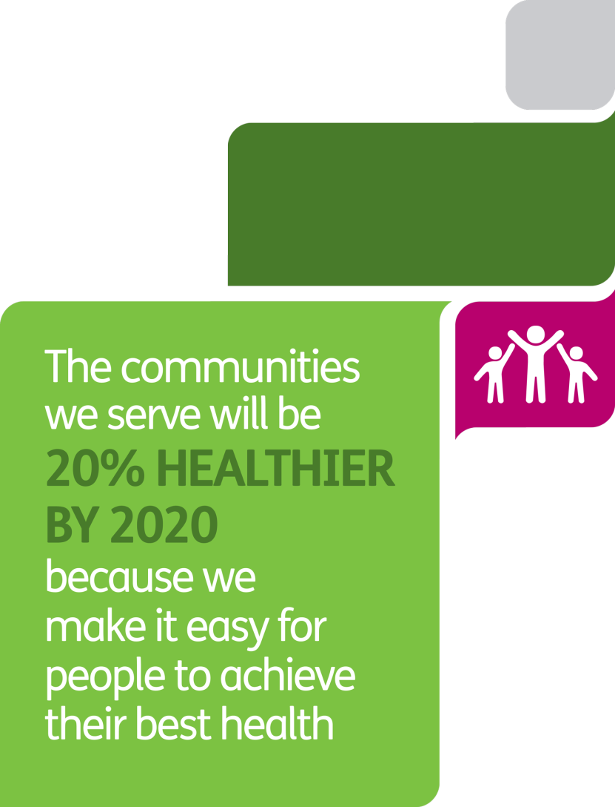
How we approach our goal
  Communities we serve are the populations of members and associates whose health Humana impacts
  20% healthier refers to the overall health – physical & mental – of our Humana associates and members
  We make it easy acknowledges that health is hard and at Humana we have to simplify everything
  Achieving best health acknowledges that “health” is personally defined and different for different people
help
57
Notes:
The approach to our goal is a strategic one
These are some key elements and how we talk about them and define them
We think about the communities we serve this way – populations of members and associates whose Health Humana impacts
Our associates who are leading the way in our journey
These communities are geographic like the 500,000 plus Humana members in San Antonio
Also clinically defined by diseases like diabetes and congestive heart failure
Health refers to overall health – physical and mental – and how they perceive their health
We acknowledge health is hard and at Humana we have to simplify it.
Health is personally defined and different for different people – no one size fits all

Slide 58






Start with Healthy: Closing the Gap in 2015
Over 452K new Medicare Advantage members received a new member assessment
3.9M gaps in care closed
314K drug safety alerts resulted in discontinued scripts
Over 47K members with behavioral health needs engaged by care managers
Notes:
Stats from 12/22/15
452,822 is 67 percent of new Medicare members
For 3.0 M members with no care gaps, 1.8 M have remained compliant since beginning of the year
3.9 M gaps in care closed:
298K Stars gaps closed
3.29M gaps closed for medication adherence and appropriate tests/screenings
314K (87%) of drug safety alerts resulted in discontinued scripts (featured on next slide)
PODS: Well on their way of reaching their annual goal of 80,000 face to face visits
2.5 million members in 4 Star Plans (featured instead of the 3.96 overall Star Ratings)

Slide 59

Providers

Slide 60



Humana Joint Ventures and Owned Entities
20 Humana-owned multispecialty medical centers.
Receive all necessary preventative care under one roof!
Independent practices and 19 Humana-owned medical centers.
Implementing an electronic health records system to operate across all clinics.
A joint venture. Multispecialty medical centers operate in six major U.S. markets .
Serving Medicare and private-pay patients in medically underserved areas.
Notes:
CAC Florida Medical Centers have a coordinated, comprehensive, repeatable model for providing primary care to members. The Humana-owned centers give members access not just to a physician office, but to a multispecialty, patient-centered medical home where they can receive all of their recommended preventive care. With CAC Centers providing most of the care a member may need under one roof, the care is naturally coordinated, doctors work as teams when caring for patients, and members are less likely to slip through the cracks after they leave
Continucare demonstrates how information systems can help transform primary care. Because the Humana-owned network provides pediatric, adult and geriatric care, it has adopted an inclusive approach to care for patients of varying ages and health needs, and it is intently focused on improving population health. In line with those goals, Continucare is implementing an electronic health records system to operate across all of the clinics, giving every facility access to needed patient records as well as the same scheduling platform and referral management system. Such standardization allows primary care professionals to get back to doing what they do best: focusing on keeping their patients well and keeping them out of the hospital.
JenCare demonstrates how access to care is about getting patients the right care at the right place at the right time. The multispecialty facilities —operated through a Humana joint venture— can provide needed specialty care onsite, sometimes the same day as the primary care office visit. If patients need services at the clinics but don’t have a good way to get there, JenCare provides van transportation with pickup service. Patients needing prescriptions can receive many of them from the on-location pharmacy

Slide 61
Humana Joint Ventures and Owned Entities
A medical group founded by physicians.
Operates in Humana-owned medical centers and independent offices.
15 Humana-owned multispecialty medical centers.
A team approach to senior focused primary care.
12 Humana-owned multispecialty medical centers.
New centers opening in the fall of 2017.
Notes:
MCCI and MetCare(link opens in new window)  demonstrate that good patient coordination doesn’t necessarily require one singular approach to delivering primary care. Although many of the patients receive comprehensive care through Humana-owned multispecialty clinics, they also can receive care from independent physician offices that contract with the networks. In this way, MCCI and MetCare can offer resources that help patients receive the care they need and help physician offices function well and manage risk—all while retaining accountability for a patient's total care.

Slide 62
Compliance

Slide 63
Section As by External Sub Channels 3rd QTR 2016 through 2nd QTR 2017
CallCenter/eVendor
FMO and National Agencies

Slide 64
Section A Classification Analysis
The following are the top 3 Categories of Complaints
  D (Presentation and Benefits)
  B (Enrollment and Eligibility)
  A (Provider)
Code | Description
A | Provider
B | Enrollment/Eligibility
C | Solicitation
D | Presentation/Benefits
E | Agent Compliance
F | Supplemental
G | Pharmacy Issues
H | Competency
I | Forgery
J | Cancellation/Disenrollment Request
K | Unethical Sales Tactics
L | Other
M | OSB

Slide 65
What’s the takeaway?
Examples of issues observed in allegations for each of the top 3 categories
Provider participation –
  Incorrectly determining PPO versus HMO participation
  Not recognizing that different HMO plans may have different HMO networks
  Assuming that because a Provider Group is in network, all Providers in the group are in network
Presentation/Benefits –
  Did not use presentation or SOB
  Misrepresented or failed to disclose plan benefits or premium
  Misquoted Medical CoPay and/or Prescription CoPay
Enrollment/Eligibility –
  Incorrect Effective Date
  Incorrect Election Codes
  Enrolled in wrong plan or they did not want to enroll.
  MA vs. Med Supp confusion

Slide 66
Compliance Reminders
Absolute superlatives AND Qualified superlatives are prohibited. Examples include:
  “This plan is the [best, highest rated, rated #1] in the area”
  “Most recognizable name in the market”
  “Largest provider network”
  “One of the best”
  “Among the Highest Ranked”
Stick to your CMS/Humana approved script when presenting the plan
  Do not advise any MA/MAPD as being “like” or “similar” to a Medicare Supplement
  Please make sure the member is clear on the difference between Medicare Supplement and Medicare Advantage.
  If the member continuously refers to an MA plan as a Med Supp plan, confirm that the member understands the difference and what plan you are selling them.
Offer to check any drugs that the member may be taking.
Know what states you are licensed, appointed, and certified in to avoid compliance action
Understand the Power of Attorney requirements (competency level)
Notes:
North Carolina example

Slide 67
Summary of Benefits
Section As can result when a member is not clearly advised of the plan benefits.
Plan Basics
  Explanation as to how plan works (e.g. HMO, PPO, PFFS)
  Monthly premium
  In Network/Out of Network benefits
  PCP requirements
  Provide at least two cost sharing/coinsurance examples, such as PCP and Specialists visits.
  Inform beneficiary that additional enrollment material is forthcoming, including ID card
Explain physician/pharmacy network may change and may find an up-to-date list on the Plan/Part D Sponsor’s website
This is why reviewing the Summary of Benefits is important because you want them to be informed of the plan benefits.

Slide 68
Value Added Services (VAS) vs.
Supplemental Benefits Reminder
Value Added Services
Value Added Services (VAS) may not be discussed during the Medicare Advantage appointment.
The prospect must be a member before the Value added services for a plan can be discussed.
Agents are not permitted to discuss or mention VAS while setting an appointment or during the initial sales presentation
  The reason for this change is because VAS benefits are not guaranteed to be offered with the plan through the duration of the year.
If a member asks questions about a VAS, the agent can answer the question but should say the following VAS disclaimer
Value Added Services Disclaimer “Yes, we do have some additional discounts and services and they vary by geographic area. However, those additional discounts and services are not considered actual benefits of the plan and are not really part of what we think you should be basing your enrollment decision on. In fact, CMS asks us not to discuss them until you actually become a member so that the focus isn’t taken off of what is most important”
Supplemental Benefits
A supplemental benefit is an item or service not covered by Original Medicare, that is primarily health related and for which the MA plan must incur a non-zero direct medical cost.
Supplemental Benefits include: WellDine, SilverSneakers and Humana Active Outlook (HAO)

Slide 69

69

